Slide 1
ELEVATE LABS INTERNSHIP
Tanvi Nitin Paygude
Task 4

Slide 2
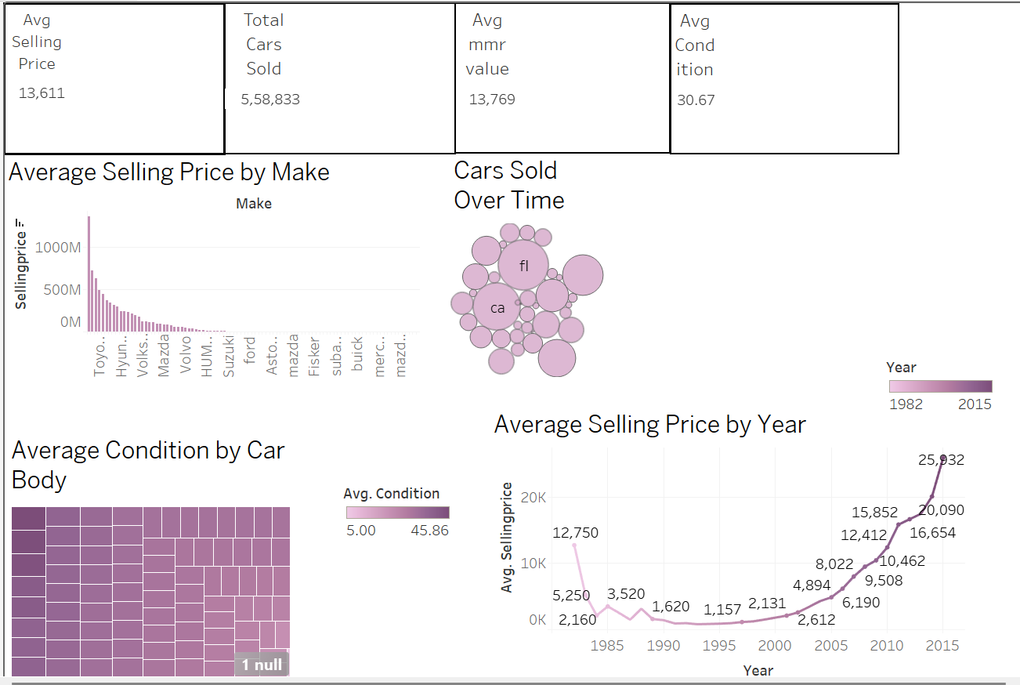
Interactive Dashboard for Car Pricing Data

Slide 3
Task Objective & Tools Used
Objective: To design an interactive dashboard for business stakeholders using a car pricing dataset.
Tools Used: Tableau Desktop Dataset from: Kaggle (Car Prices)
Goal: Provide insights into pricing, condition, odometer, and trends over time.

Slide 4
THANKYOU!

Slide 5
Dataset Summary
Total Records: ~5.5 lakh+ cars
Key Fields Used:
sellingprice, mmr, condition, odometer, make, year, state, saledate
Time Period Covered: 1982 to 2015
Purpose: Understand factors influencing car price and sales trends

Slide 6
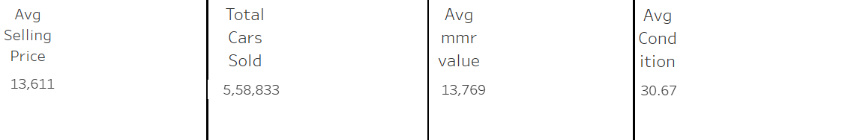
Key Performance Indicators (KPI Cards)
KPI | Insight
Avg Selling Price | ₹13,611 – What buyers typically pay
Total Cars Sold | 5,58,833 unique cars
Avg MMR Value | ₹13,769 – Market reference price
Avg Condition | Score of 30.67 (scale 0–50)

Slide 7
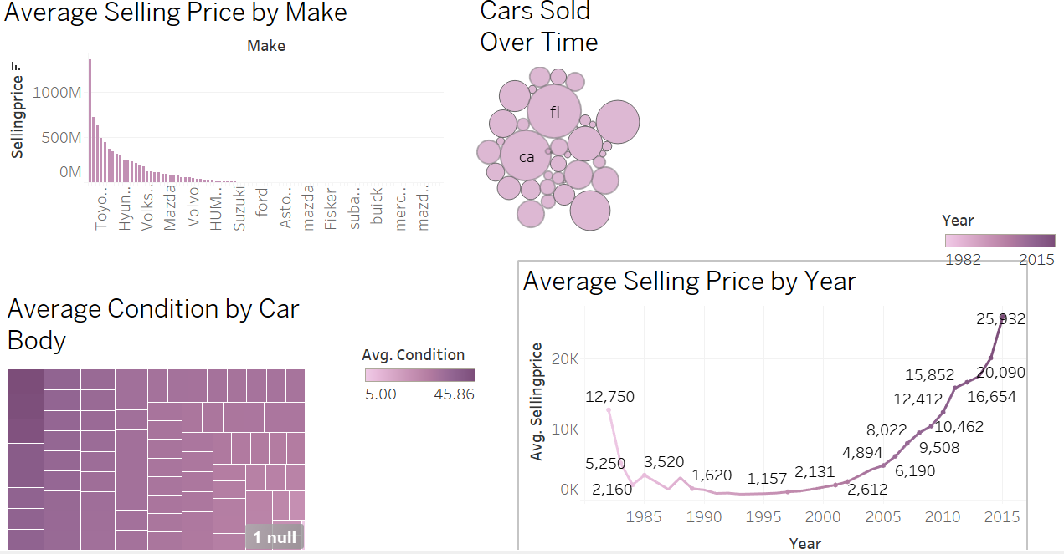
Dashboard Visualizations
Sheet | Description
Sheet 1 | Selling Price by Make – Top brands by total revenue
Sheet 2 | Car Sales by State – Bubble map highlighting FL, CA, PA
Sheet 3 | Condition Analysis – Heatmap of car condition scores
Sheet 4 | Avg Selling Price Over Years – Trend from 1982 to 2015

Slide 8
Insights & What I Learned
Most cars sold were in good condition (20–40 score)
Car brands like Toyota & Hyundai dominate sales
Older cars have lower resale value; newer cars show rising price trends
States like FL, CA, PA see higher volumes
Learned how to use Tableau for: filtering, KPIs, time-series, and layout

